Slide 1
KINS - System Overview
Oct 24, 2017
Notes:
GLOBAL NOTE When using different layouts for our HCC template:
Please use the bounding area given inside the title and text boxes and DO NOT stretch to make text fit outside area.
This is so we have consistent space around text and keep the margins given for consistent brand throughout.
When applying a new “Layout” make sure you hit the “reset” button to lock the alignment on titles, subtitles and text.
Try to keep text size consistent throughout. If you have a long title, you may have to make part of it as a subtitle to fit.

Slide 2
Overview
Architecture Overview
Shiny license

Slide 3
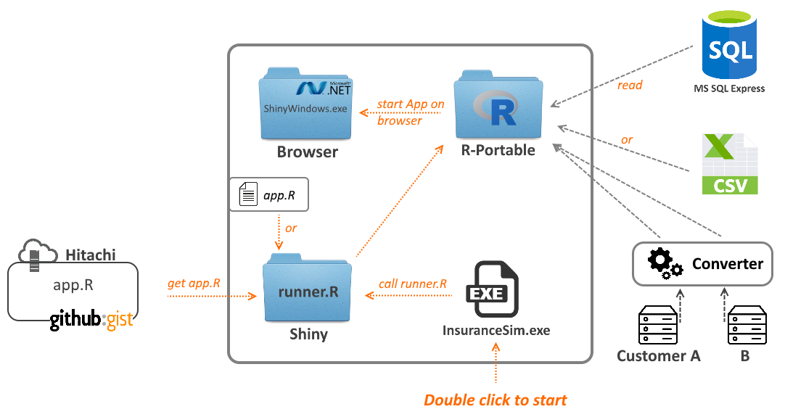
Architecture Overview

Slide 4
Architecture Overview - Folder Structure of the package
Folder structure:
- Application-Folder/
- Browser/
- ShinyWindow.exe [An application integrates a [.net] browser]
- R-portable/ [R-portable folder]
- Shiny/
- runner.R [A script installs lib if any, then start app.R on gist.github or local]
- app.R [Sourcecode of Rshiny app. Locate here on or gist.github]
- InsuranceSim.exe [Double click this file to start the Rshiny application]

Slide 5
Architecture Overview - Packing
R-portable:
Download at: https://sourceforge.net/projects/rportable/
Add to the bottom of R-Portable/App/R-Portable/etc/Rprofile.site:
.First = function(){
.libPaths(.Library)
}
Note: This will force R-Portable to only use its local library (specified in the hidden global variable .Library) for installing/loading packages.
.Net framework:
Download at: https://www.microsoft.com/en-us/download/details.aspx?id=55167
Installation is not required from Windows 8.
Refers: https://docs.microsoft.com/en-us/dotnet/framework/get-started/system-requirements

Slide 6
Architecture Overview - Packing (cont.)
app.R:
Add to server R the function session$onSessionEnded as below
shinyServer(function(input, output, session){
session$onSessionEnded(function() {
stopApp()
})
})
- This function to ensure that it will stop the web socket server started by shiny::runApp() and the underlying R process when the browser window is closed.

Slide 7
Architecture Overview - Packing (cont.)
ShinyWindow.exe:
This is a Window form application which is integrated a .net browser.
Configured with default url: http://127.0.0.1:8888
InsuranceSim.exe:
A console application which performs:
Create Wscript.Shell and run R.exe from R-portable
Setting lib paths to R-portable folder
Start shiny app local: shiny::runApp("./Shiny/",port=8888,launch.browser=TRUE)
or shiny app on gist: shiny::runGist([GISTID],port=8888,launch.browser=TRUE)

Slide 8
Shiny license
Shiny package is distributed under GPL-3 license (GNU GENERAL PUBLIC LICENSE version 3).
It includes other open source software components:
jQuery, https://github.com/jquery/jquery
jQuery UI (some components), https://github.com/jquery/jquery-ui
Bootstrap, https://github.com/twbs/bootstrap
html5shiv, https://github.com/aFarkas/html5shiv
Respond.js, https://github.com/scottjehl/Respond
bootstrap-datepicker, https://github.com/eternicode/bootstrap-datepicker
Font Awesome, https://github.com/FortAwesome/Font-Awesome
selectize.js, https://github.com/selectize/selectize.js
es5-shim, https://github.com/es-shims/es5-shim
ion.rangeSlider, https://github.com/IonDen/ion.rangeSlider
strftime for Javascript, https://github.com/samsonjs/strftime
DataTables, https://github.com/DataTables/DataTables
showdown.js, https://github.com/showdownjs/showdown
highlight.js, https://github.com/isagalaev/highlight.js
tar implementation from R, http://www.r-project.org/
Detail license info: https://github.com/rstudio/shiny/blob/master/LICENSE

Slide 9
Thank you

